Slide 1
Sekapur Sirih Jaringan Komputer
Gandeva Bayu Satrya (GBS)
gandeva.bayu.s@gmail.com
TELKOM INSTITUTE of TECHNOLOGY

Slide 2
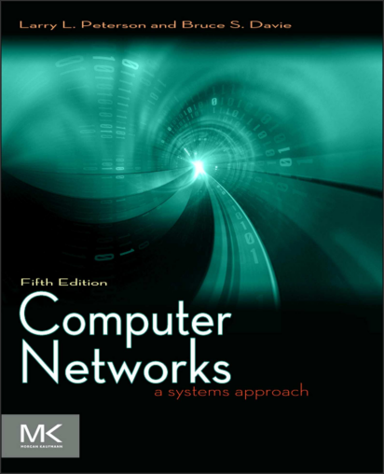
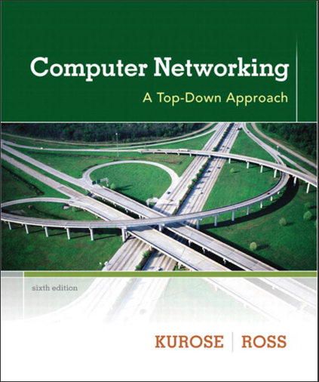
References

Slide 3
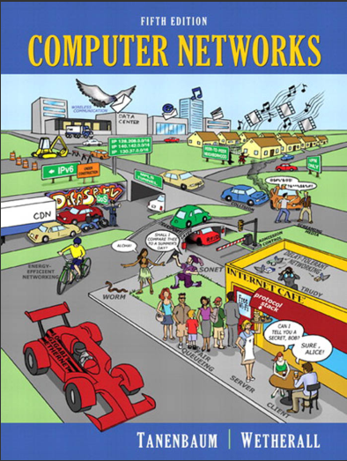
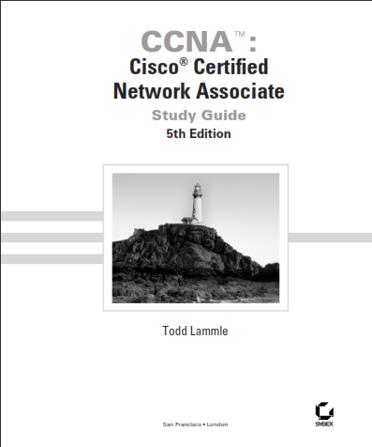
Add. References

Slide 4
References Details
Chapter 1 : Foundation
Chapter 2 : Getting Connected
Chapter 3 : Internetworking
Chapter 4 : Adv. Internetworking
Chapter 5 : End to End Protocols
Chapter 6 : Congestion Control & RA
Chapter 7 : End to End Data
Chapter 8 : Net Security
Chapter 9 : Application

Slide 5
Rules
Use 2012’ s Curiculum
Scoring
Pre, Post, & Task (SCL) : 20%
Attitute (SCL) : 10%
Mid Test : 35%
Final Test : 35%
Penalty
Plagiarism → E
Attendance → >= 75% (Roster)

Slide 6
Lecture’s Profile
Mia Rosmiati S.Si., M.T
081223228338
m14_r@yahoo.com
Ketua kelas : frans shandyto
082240204567
fshandyto@myself.com

Slide 7
Kontrak Perkuliahan
1.RFID sendiri
2. Keterlambatan = 20’
3. Seragam
4. Boleh makan dan minum di luar kelas kecuali air bening, transparan dan tawar
5. Tugas = terlambat -3 point/ jam
6. Perizinan = harus ada surat izin
7. Sakit = harus ada surat sakit
8. Kerjasama → yang diconteknya = 0
9. Tubes → masih menunggu

Slide 8
Chapter 1 Introduction
Gandeva Bayu Satrya (GBS)
gandeva.bayu.s@gmail.com
TELKOM INSTITUTE of TECHNOLOGY

Slide 9


Agenda
Chapter 1. Comp.Net & The Internet
1.1 What is the Internet?
1.2 Network Edge
1.3 Network Core
1.4 QoS : Delay, Loss, and Throughput
1.5 Protocol Layers
1.6 Introduction to Comp. Security

Slide 10

1.1 What is the Internet?
Internet: “network of networks”
loosely hierarchical
public Internet versus private intranet
Internet standards
RFC: Request for comments
IETF: Internet Engineering Task Force
http://www.ietf.org/rfc.html

Slide 11
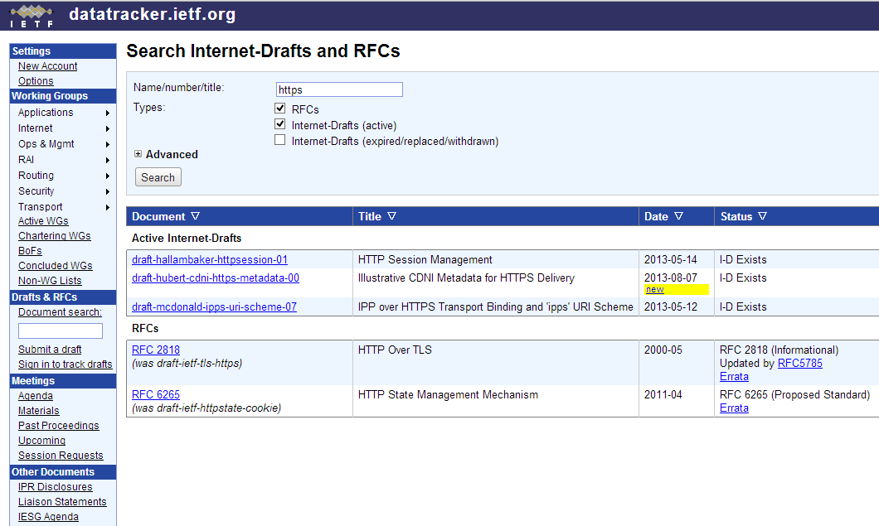

Slide 12
1.1.1. “nuts and bolts” View
millions of connected computing devices (hosts)
communication links (transmission rate / bandwidth)
routers (forward packets)
protocols (control sending and receiving of msgs)

Slide 13
1.1.2. a Service View
communication infrastructure (enables distributed applications)
communication services provided to apps (Reliable and UnReliable)

Slide 14
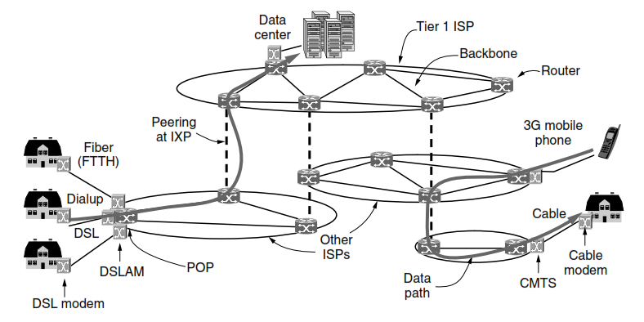
Internet ^{[Tanenbaum 2011]}
The Internet is not really a network at all, but a vast collection of different networks that use certain common protocols and provide certain common services.

Slide 15
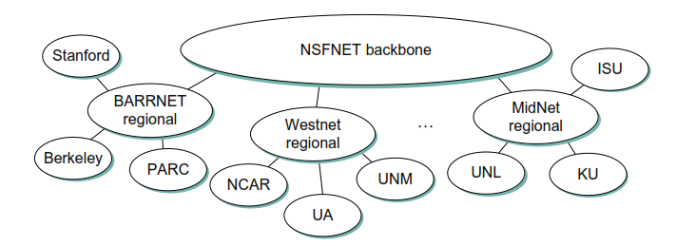
Internet ^{[Perterson 2012]}
Internet in 1990’s
... how to connect a heterogeneous collection of networks to create an internetwork and how to use the simple hierarchy of the IP address to make routing in an internet somewhat scalable.

Slide 16
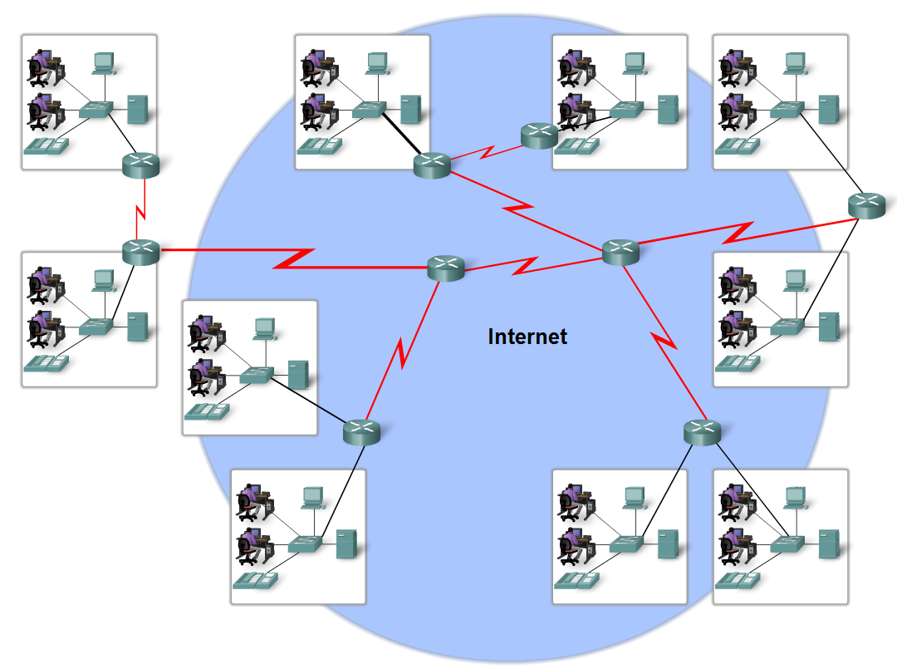
Internet ^{[Lammle 2005]}
The internet is defined as a global mesh of interconnected networks ...

Slide 17
1.1.3. Protocols
… specific msgs sent
… specific actions taken when msgs received, or other events
all communication activity in Internet governed by protocols
protocols define format, order of msgs sent and received among network entities, and actions taken on msg transmission, receipt

Slide 18
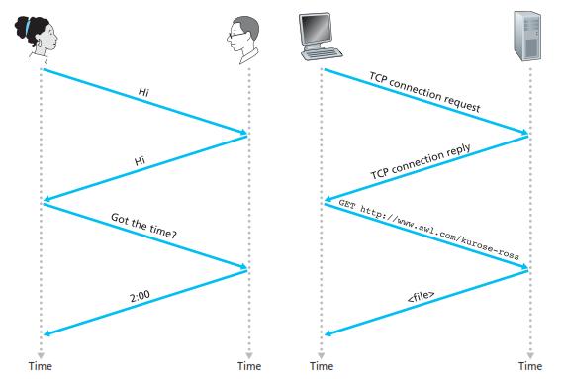
1.1.3. Protocols

Slide 19
Agenda
Chapter 1. Comp.Net & The Internet
1.1 What is the Internet?
1.2 Network Edge
1.3 Network Core
1.4 QoS : Delay, Loss, and Throughput
1.5 Protocol Layers
1.6 Introduction to Comp. Security

Slide 20
1.2. Network Edge
Client/server Programs : end systems (email hosts), website (http), and peer-peer model (skype)
Access Networks : wired, wireless communication links
Physical Media : guided (copper, fiber, coax) and unguided (Wireless, Radio, and Satellite)

Slide 21
1.2. Network Edge
How to connect end systems to edge router?
bandwidth (bits per second) of access network?
shared or dedicated?
Dial-up Modem (TSEL Flash)
A/X-DSL (Telkom Speedy)
Fiber Optic to The Home (Biznet)
Ethernet Internet Access (Campus)
Wireless Access Net (Hotel, Mall, Airport, etc..)

Slide 22
Agenda
Chapter 1. Comp.Net & The Internet
1.1 What is the Internet?
1.2 Network Edge
1.3 Network Core
1.4 QoS : Delay, Loss, and Throughput
1.5 Protocol Layers
1.6 Introduction to Comp. Security

Slide 23
1.3. Network Core
Mesh of interconnected Routers
the fundamental question: how is data transferred through net?
circuit switching: dedicated circuit per call: telephone net
packet-switching: data sent thru net in discrete “chunks”

Slide 24

1.3.1. Circuit Switching
End-end resources reserved for “call”
link bandwidth, switch capacity
dedicated resources: no sharing
circuit-like (guaranteed) performance
call setup required
Ex: E1/T1, FDMA, TDMA, CDMA, and OFDMA

Slide 25
1.3.2. Packet Switching
each end-end data stream divided into packets
user A, B packets share network resources
each packet uses full link bandwidth
resources used as needed
resource contention:
aggregate resource demand can exceed amount available
congestion: packets queue, wait for link use
store and forward: packets move one hop at a time
Node receives complete packet before forwarding
Ex: Computer Networks

Slide 26
1.3.2. Packet Switching
100 Mb/s
Ethernet
A
C
statistical multiplexing
1.5 Mb/s
B
queue of packets
waiting for output
link
D
E

Slide 27
1.3.3. ISPs and Internet
ISP
User PCs, PDAs, Web servers, mail servers, and so on connect into the Internet via a local ISP.
In the public Internet, access ISPs situated at the edge of the Internet are connected to the rest of the Internet through a tiered hierarchy of ISPs
Internet is a network of networks.
Access ISPs are at the bottom of this hierarchy.

Slide 28
1.3.3. ISPs and Internet
Internet Backbones
At the very top of the hierarchy is a relatively small number of so-called tier-1 ISPs. Tier-1 ISPs are also known as Internet backbone networks.
A tier-2 ISP typically has regional or national coverage, and (importantly) connects to only a few of the tier-1 ISPs
A tier-3 ISP typically has sub/smaller ISP/operator.

Slide 29
1.3.3. ISPs and Internet
Internet Backbones
local
ISP
Tier 3
ISP
local
ISP
local
ISP
local
ISP
Local and tier- 3 ISPs are customers of
higher tier ISPs
connecting them to rest of Internet
Tier-2 ISP
Tier-2 ISP
Tier 1 ISP
Tier 1 ISP
Tier 1 ISP
Tier-2 ISP
Tier-2 ISP
Tier-2 ISP
local
ISP
local
ISP
local
ISP
local
ISP

Slide 30
1.3.3. ISPs and Internet
Internet Backbones
local
ISP
Tier 3
ISP
local
ISP
local
ISP
local
ISP
Tier-2 ISP
Tier-2 ISP
Tier 1 ISP
Tier 1 ISP
Tier 1 ISP
Tier-2 ISP
Tier-2 ISP
Tier-2 ISP
local
ISP
local
ISP
local
ISP
local
ISP

Slide 31
Agenda
Chapter 1. Comp.Net & The Internet
1.1 What is the Internet?
1.2 Network Edge
1.3 Network Core
1.4 QoS : Delay, Throughput, and Losses
1.5 Protocol Layers
1.6 Introduction to Comp. Security

Slide 32
1.4. Delay, Throughput, & Loss
Ideally, we would like Internet services to be able to move as much data as we want between any two end systems, instantaneously, without any data loss.
This is a lofty goal, one that is unachievable in reality. Instead, computer networks necessarily constrain ;
throughput (the amount of data per second that can be transferred)
between end systems, introduce delays between end systems,
and can actually lose packets.

Slide 33
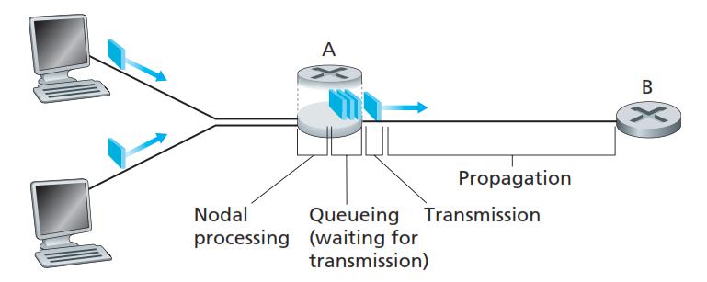
1.4.1. Delay
The most important of these delays are the nodal processing delay, queuing delay, transmission delay, and propagation delay; together, these delays accumulate to give a total nodal delay.

Slide 34
1.4.1. Delay
If we let d_{proc}, d_{queue}, d_{trans}, and d_{prop} denote the processing, queuing, transmission, and propagation delays, then the total nodal delay is given by
d_{proc} = processing delay
typically a few microsecs or less
d_{queue} = queuing delay
depends on congestion
d_{trans} = transmission delay
= L/R, significant for low-speed links
d_{prop} = propagation delay
a few microsecs to hundreds of msecs

Slide 35
Agenda
Chapter 1. Comp.Net & The Internet
1.1 What is the Internet?
1.2 Network Edge
1.3 Network Core
1.4 QoS : Delay, Throughput, and Losses
1.5 Protocol Layers
1.6 Introduction to Comp. Security

Slide 36
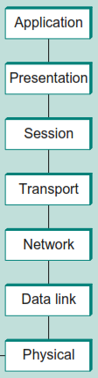
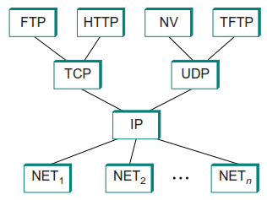
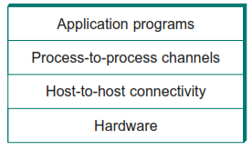
1.5. Protocol Layer
Layered System TCP/IP or Internet OSI

Slide 37
Task 1
Sifat tugas = Kelompok
Tugas = buatlah 1 jenis Socket Programming (apa saja)
Dikumpul max selasa (10/9/13) 9.00 AM
Via email
gbs@ittelkom.ac.id
gandeva.bayu.s@gmail.com

Slide 38
Bibliography
Kurose, J.F., and Ross, K.W., Computer Networking : A Top-Down Approach Sixth Edition, Pearson Education, Inc. USA, 2013.
Peterson, L.L., and Davie, B.S., Computer Networks: A Systems Approach Fifth Edition, Morgan Kaufmann, Burlington USA, 2012.
Tanenbaum, A.S., and Wetherall, D.J., Computer Networks Fifth Edition, Pearson Education, Inc., Boston USA, 2011.
Lammle T., Cisco Certified Network Associate : Study Guide Fifth Edition, Sybex, Inc. USA, 2005.

Slide 39
Thank You
Gandeva Bayu Satrya (GBS)
gandeva.bayu.s@gmail.com
TELKOM INSTITUTE of TECHNOLOGY

